Slide 1
Business and Industrial Economics
Prof. Luca Grilli
Firm heterogeneity, market power and price discrimination

Slide 2
Classification of market structures
P.c.
Potential competition
Oligopoly
Dominant firm
Monopoly
Monopolistic competition & Competitive selection
Market power

Slide 3
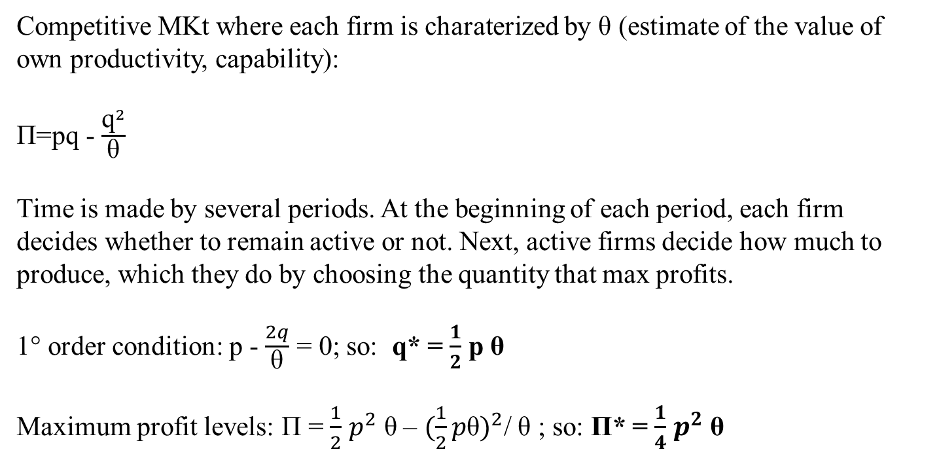
Competitive selection model
Jovanovich 1982, Econometrica
Competitive MKt where each firm is charaterized by θ (estimate of the value of own productivity, capability):
Π=pq - $\frac{{\text{q}}^{2}}{\text{θ}}$
Time is made by several periods. At the beginning of each period, each firm decides whether to remain active or not. Next, active firms decide how much to produce, which they do by choosing the quantity that max profits.
1° order condition: p - $\frac{2q}{\text{θ}}$ = 0; so: q* = $\frac{1}{2}$ p θ
Maximum profit levels: Π = $\frac{1}{2}$ $p^{2}$ $\text{θ}$– ${(\frac{1}{2}p\text{θ})}^{2}$/ θ ; so: Π* = $\frac{1}{4}$ $p^{2}$ $\text{θ}$

Slide 4
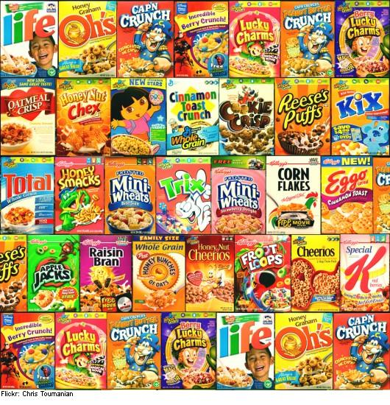
Monopolistic competition
Chamberlin (1933, p. 57): “It is evident that virtually all products are differentiated, at least slightly, and that over a wide range of economic activity differentiation
is of considerable importance” (from The Theory of Monopolistic Competition)

Slide 5
Monopolistic competition
5 central assumptions of perfect competition
Atomicity
Product homogeneity.
Perfect information (every agent, firms and consumers) know the price charged by every firm.
Firms have access to all technologies.
No entry and exit barriers (free entry and exit)
Product differentiation
Firm is a price-maker. Each firm faces a downward-sloping demand curve
Note: typically greater differentiation makes demand less elastic

Slide 6

Monopolistic Competition in the Short Run
Price
Signal for entry
MC
AC
Price
Average
cost
Demand
Profit
MR
Demand will reduce
0
Profit-
Quantity
maximizing
quantity

Slide 7
Monopolistic Competition in the Long Run
Price
MC
No signal for entry
AC
P
=
AC
Is stable
Demand
MR
0
Profit-maximizing
Quantity
quantity
Copyright©2003 Southwestern/Thomson Learning

Slide 8
Appendix: COURNOT duopoly output (see Cabral 2000, chapter 7, p. 112): why generally «OLIGOPOLY» stays in the middle
STRATEGIC VARIABLE: Quantity
p = a – b(q1 + q2)
Π1 = pq1 – cq1 = [a – b(q1+q2)]q1 – cq1
Π2 = pq2 – cq2 = [a – b(q1+q2)]q2 – cq2
dΠ1/dq1 = a – 2bq1 – bq2 – c = 0 q1* = [(a – c) /2b] – (1/2)q2*
dΠ2/dq2 = a – 2bq2 – bq1 – c = 0 q2* = [(a – c) /2b] – (1/2)q1*
You will see Oligopoly with Prof. Pedota
q1
q2(q1)
q1* = q2*
(q1* + q2* = QOLIGOPOLY)
Q produced in monopoly
Q produced in perfect competition
q1(q2)
q2

Slide 9
Final taxonomy
P. C. : p min; Q max; Sc max; Null extra-profits; max W (from a static point of view).
Potential Competition: close (or not too distant) results to (from) p.c.
Monopolistic competition (with moderate differentiation) and Comp. selection: close (or not too distant) results to (from) p.c.
Oligopoly: p intermediate; Q intermediate; Sc intermediate; Positive extra-profits; Intermediate W (static).
Dominant Position: close (or not to distant) results to (from) monopoly (see below)
Monopoly: p max; Q min; Sc min; Extra-profits max; W min (static)

Slide 10
Business and Industrial Economics
Prof. Luca Grilli
Price discrimination: Part 1

Slide 11
PRICE DISCRIMINATION 1°, 2°, 3°

Slide 12
Why do firms want to “discriminate”?

Slide 13
Perfect price discrimination (I°)
(Pigou, 1920):
One consumer - One price for each unit sold
Each customer is charged a different price – exactly matching his/her willingness to pay for each unit
Max Producer Surplus.
Max Social Welfare.
Equity problems: no Consumer’s Surplus.
Problems:
Which is the wtp of each consumer is difficult to know
Difficult to avoid arbitrage (absence of resale).

Slide 14

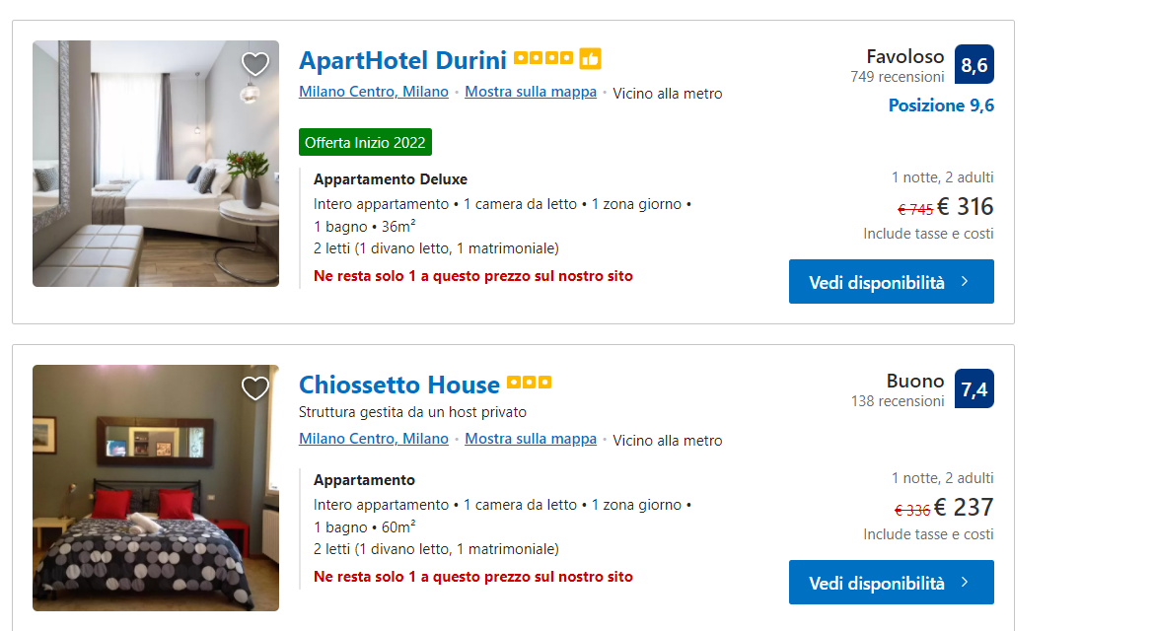
Consumer profiling (or price steering) via devices already exists (search made by myself through Booking.com via smartphone (left) and desktop (right))

Slide 15
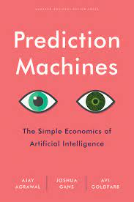
From “shopping-then-shipping” to “shipping-then-shopping”?
Most shoppers have noticed Amazon’s recommendation engine while they shop. At present, Amazon’s AI does a reasonable job suggesting items for customers to buy, particularly considering the millions of items on offer. However, the company’s predictions are far from perfect. […] Now, imagine that Amazon’s AI collects more information about us: In addition to our searching and purchasing behavior, it also collects other data it finds online, including social media, as well as offline, such as our shopping behavior at Whole Foods. It knows not only what we buy, but also what time we shop, which location we shop at, how we pay and more. What if the AI uses that data to improve its predictions? What happens to Amazon’s strategy as its data scientists, engineers and machine learning experts work tirelessly to dial up the accuracy on the prediction machine?
At some point, the AI’s prediction accuracy crosses a threshold, such that it becomes in Amazon’s interest to change its entire business model. The predictions become sufficiently accurate that it becomes more profitable for Amazon to ship you the goods that it predicts you’ll want rather than wait for you to order them.[…..]
By Ajay Agrawal, Joshua Gans and Avi Goldfarb – Harvard Business Review, Oct 4, 2017.

Slide 16
3° Price discrimination
“Group” Pricing: different prices for different groups of consumers, same price within the same group.
Selection by (exogeneous) indicators:
Age
Occupation
Geography
(Internet) Device
Examples: geographical market segmentation (books in India and UK); special discounts (professionals and students); mode of buying.

Slide 17
Trick: apply elasticity rule to each market segment.
- In sub-market i: max π_{i} = TR(q_{i}) – TC(q_{i}) o p_{i}(q_{i}) · q_{i} – TC(q_{i})
- In sub-market j repeat the same and obtain:
Of course absence of resale possibilities is needed also in this case
Implications:
Rule: different elasticities = different prices.
Specifically, higher prices in less elastic markets
first order condition:

Slide 18
Uniform pricing vs. 3° Price discrimination
A. Uptown
B. Downtown
C. Total
P
P
P
a_{S}
P*_{T}
MC
D_{U}
D_{D}
D_{T}
Q*_{U}
Q*_{D}
MR_{D}
Q_{S}
Q_{kink}
Q*
Q_{TOT}
MR_{U}
MR_{TOT}

Slide 19
Exercise on 3° price discrimination
No fixed costs, marginal costs constant and equal to 2
TC = 2q
p_{u} = 8 - q_{u}
p_{d} = 5 - q_{d}
p_{T} = 8 – q_{T}
p_{T} = 6.5 – 0.5 q_{T}

Slide 20
Scenario A: price discrimination
f.o.c in U: 8 – 2q_{u} = 2; q_{u} = 3; p_{u} = 5; π_{u} = 9
f.o.c in D: 5 – 2q_{d} = 2; q_{d} = 1.5; p_{d} = 3.5; π_{d} = 2.25
Total π_{ud} (in this case = S^{p}) = 11.25
Total S^{c}: S^{cu} (= 4.5) + S^{cd} (= 1.125) = 5.625
W = 16.875
Scenario B: no price discrimination
f.o.c in T: 6.5 – q_{T} = 2; q_{T} = 4.5; p_{T} = 4.25; π_{T} (again = S^{p}) = 10.125
S^{c} = 4.5 + [(4.5+3)*0.75]/2 = 7.3125
W = 17.4375

Slide 21
Exam question February 7th 2020

Slide 22
Example of third degree price discrimination
Markups in the car market (Verboven, 1996)
Model | France | Germany | Italy
Fiat Uno | 8.7 | 9.8 | 21.7
Peugeot 405 | 13.4 | 10.2 | 9.9
Mercedes 190 | 14.4 | 17.2 | 15.6

Slide 23
Example of third degree price discrimination
Markups in the car market (Verboven, 1996): the “home bias”
Model | France | Germany | Italy
Fiat Uno | 8.7 | 9.8 | 21.7
Peugeot 405 | 13.4 | 10.2 | 9.9
Mercedes 190 | 14.4 | 17.2 | 15.6

Slide 24
2° Price discrimination
Self-selection by consumers
seller cannot directly identify consumer type, but can still induce consumers to distinguish themselves. This selection may be based on the willingness of consumers to consume:
different quantities (so price paid by consumers depends on the quantity of the good consumed: non linear-pricing, bundling)
Different versions of the same product (Versioning): (often) case of VERTICAL DIFFERENTIATION (rather than HORIZONTAL)

Slide 25
It is an ancient pricing mechanism
“It is not because of the few thousand francs which would have to be spent to put a roof over the third-class carriages or to upholster the third-class seats that some company or other has open carriages with wooden benches... What the company is trying to do is to prevent the passengers who can pay the second-class fare from traveling third class; it hits the poor, not because it wants to hurt them, but to frighten the rich. And it is again for the same reason that the companies, having proved almost cruel to third-class passengers and mean to second-class ones, become lavish in dealing with first-class passengers. Having refused the poor what is necessary, they give the rich what is superfluous.”
(Jules Depuit, “On Tolls and Transport Charges”, 1849)

Slide 26
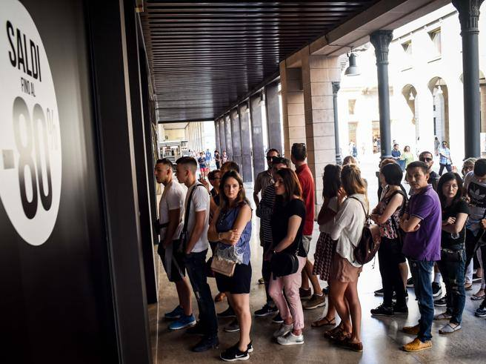

Very much used also nowadays
But place (in train) or timing (end of season sale) are only two possible dimensions to use for versioning, besides many others also depending on the product/service at stake (e.g. functionalities, customer care, information provided, etc. )

Slide 27
VERSIONING

Slide 28
Aim
To sell more than one version of the same product (e.g. premium and basic) at different prices targeting different segments of consumers (experts and beginners).
This applies also when the low quality version has the same cost of production of the high quality one (or even higher):
Software: Basic version obtained by degrading the premium through the disablement (bearing some costs) of some functions;
Information services about share prices: the “delayed” version is produced with some additional costs with respect to the “immediate” version.
Leave that consumers choose the version they prefer (self-selection).

Slide 29
Versioning
 | Impatient customers | Patient customers
Immediate Version | 100 | 50
Delayed Version | 40 | 30
Number of customers | 40 | 60
Suppose no costs, compute:
Profits with 1° price discrimination
Profits with uniform pricing
Profits with versioning??????

Slide 30
References
Cabral Industrial Organization I edition, 2000: chapter 10 [or Industrial Organization II edition, 2018: chapter 6.1-6.3].
Varian, Intermediate Microeconomics, chap. 26.7.
Further reading:
Cabral Industrial Organization I edition, 2000: chapter 6.3, 6.4 [or Industrial Organization II edition, 2018: chapter 4.2, 4.3].
Varian, Intermediate Microeconomics, chap. “Monopoly Behavior”, 26.1, 26.2, 26.3, 26.4, 26.5, 26.6)
Shapiro & Varian, Information Rules, chapter 3.

